Slide 1

Introduction to Machine Learning
Topic 2 – Resampling methods and Fine-tuning
(ISL Ch. 3 / HOML Ch. 2 / IMLP Ch. 5)
Master in Quantitative Economic Analysis MQuEA
Javier Bas
Universidad Autónoma de Madrid

Slide 2
Outline
Resampling methods
  Validation set
  Leave-one-out cross validation (LOOCV)
  k-fold cross-validation
  Bootstraping
Fine-tuning
  Grid search
  Randomized search
Master in Quantitative Economic Analysis MQuEA
Universidad Autónoma de Madrid

Slide 3
Resampling methods: the validation set
A good practice to evaluate a model is to split the training dataset into a training and a validation dataset.
We estimate the error by holding out a subset of the training observations from the fitting process, and then applying the model to those held out observations.
The process is as follows:
  Training/Test split: This is done at the very beginning of the workflow
  Training/Validation split: The training dataset is further split once again into training and validation
  Train the model in training
  Validating the model in validation (and fine tune before testing)
Master in Quantitative Economic Analysis MQuEA
Universidad Autónoma de Madrid

Slide 4
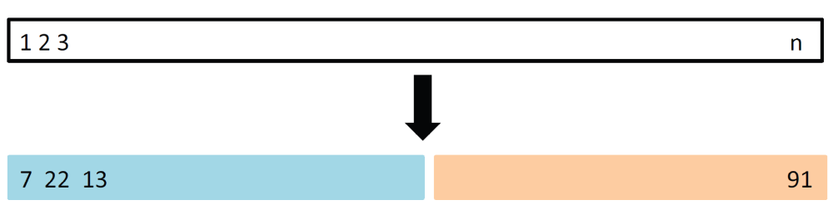
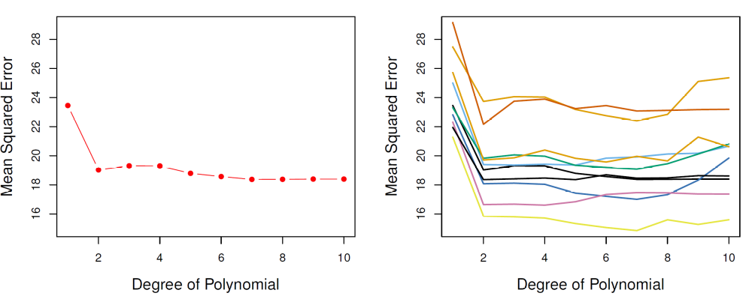
Resampling methods: The validation set
The validation set approach has an important drawback: The validation error can be highly variable, depending on which observations are included in the training/validation set.
1 single split into training and validation
Validation method repeated 10 times
Master in Quantitative Economic Analysis MQuEA
Universidad Autónoma de Madrid

Slide 5
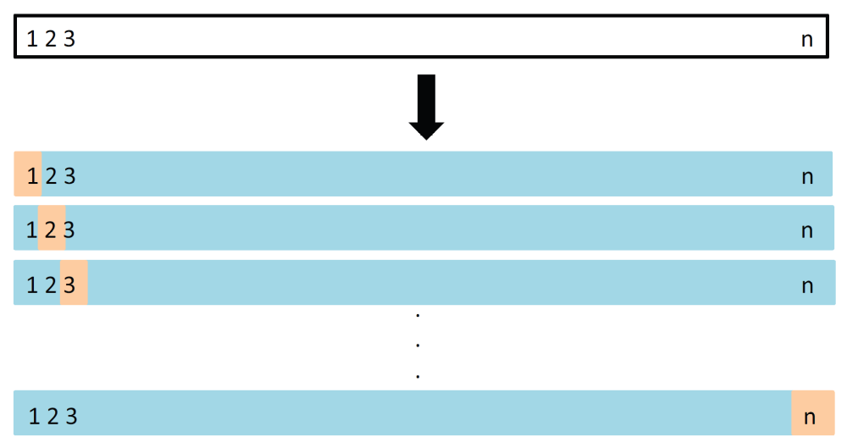
Resampling methods: Leave-one-out CV
Like the validation set approach, LOOCV involves splitting the set into two subsets. Just a single observation is held out and used for validation.
The algorithm is estimated on the n-1 training observations, then a prediction is performed in the excluding observation.
Master in Quantitative Economic Analysis MQuEA
Universidad Autónoma de Madrid

Slide 6
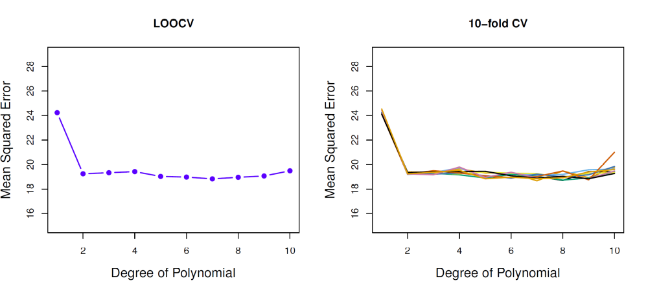
Resampling methods: Leave-one-out CV
Therefore, the model is estimating n times, leaving aside in each iteration a different observation.
Then the error is calculated as the average of all errors.
Master in Quantitative Economic Analysis MQuEA
Universidad Autónoma de Madrid

Slide 7
Resampling methods: Leave-one-out CV
LOOCV has major advantages over the validation set approach:
  The validation approach yields different results when applied repeatedly (i.e defining different training/validation partitions) because the observations are selected randomly.
  However, performing LOOCV multiple times always provide the same results since there is no randomness in the process of splitting the data.
But it also has a drawback:
  It is expensive to implement (the model is fit n times)
Master in Quantitative Economic Analysis MQuEA
Universidad Autónoma de Madrid

Slide 8
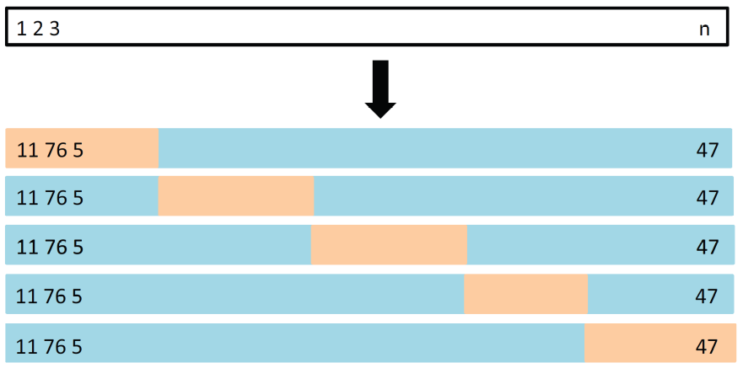
Resampling methods: k-fold CV
The set of observations is randomly shuffled and then systematically (not randomly) divided into k groups, or folds, of equal size.
The first fold is treated as a validation set, and the method is fit on the remaining k-1 holds.
The mean squared error is computed in the observations in the held-out fold.
This procedure is repeated k times, each time, a different group of observations is treated as a validation set. This process results in k estimates of the test error, and the k-fold CV estimate is the average of these values.
This plot is read left to right, top-bottom.
Master in Quantitative Economic Analysis MQuEA
Universidad Autónoma de Madrid

Slide 9
Resampling methods: k-fold CV
One advantage of using k = 5 or k = 10 (the usual values) instead k = n is computational
But there are also non-computational advantages. Some variability occurs in CV estimates due to the variability on how the observations are divided into the k folds. But it is typically lower than the variability resulting from the validation set approach.
Master in Quantitative Economic Analysis MQuEA
Universidad Autónoma de Madrid

Slide 10
Bootstraping
Bootstrapping is a method of inferring results for a population from results found on a collection of smaller random samples of that population, using replacement during the sampling process.
We repeatedly sample (with replacement) from the original data set and calculate estimators in each of those samples. Those estimations are used to compute standard deviations, confidence intervals, etc.
Master in Quantitative Economic Analysis MQuEA
Universidad Autónoma de Madrid
Notes:
https://www.mastersindatascience.org/learning/machine-learning-algorithms/bootstrapping/

Slide 11
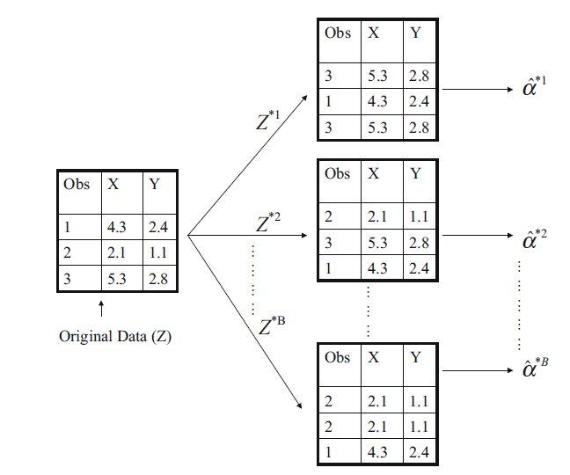
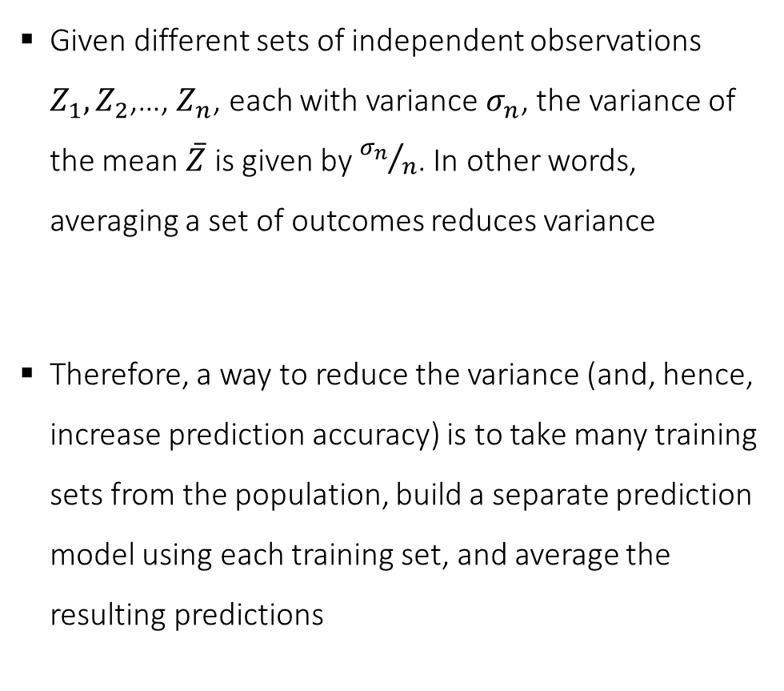
Bootstraping
Given different sets of independent observations $Z_{1},Z_{2}$,…, $Z_{n}$, each with variance $σ_{n}$, the variance of the mean $\overline{Z}$ is given by ${σ_{n}}/n$. In other words, averaging a set of outcomes reduces variance
Therefore, a way to reduce the variance (and, hence, increase prediction accuracy) is to take many training sets from the population, build a separate prediction model using each training set, and average the resulting predictions
Master in Quantitative Economic Analysis MQuEA
Universidad Autónoma de Madrid
Notes:
https://www.mastersindatascience.org/learning/machine-learning-algorithms/bootstrapping/

Slide 12
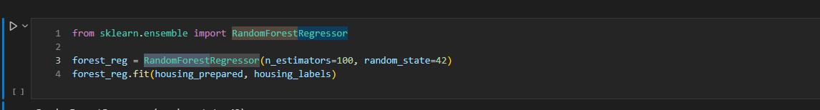
Fine-tuning
When estimating a model, we predefine certain parameters
  Number of trees in a Random Forest, maximum depth of a tree…
  Number of neurons in a Neural Network as well as number of layers
  …
Those parameters are called hyperparameters. They cannot be learnt from the data. We need to experiment with several values for them to seek for the better combination. This process is called fine-tuning.
Master in Quantitative Economic Analysis MQuEA
Universidad Autónoma de Madrid

Slide 13
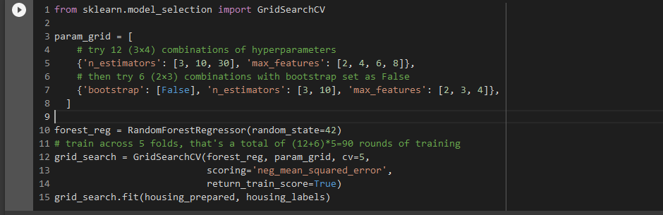
Fine-tuning: Grid search
Trying several hyperparameters manually until finding a good combination of these would be painful and maybe fruitless
However, we can define a range of values for each hyperparameter and make the algorithm fit a model for each combination of them
The best model is that with the best performance and will be used for testing.
3 x 4 + 2 x 3 = 18
5 times!
90 training rounds in total
Master in Quantitative Economic Analysis MQuEA
Universidad Autónoma de Madrid

Slide 14
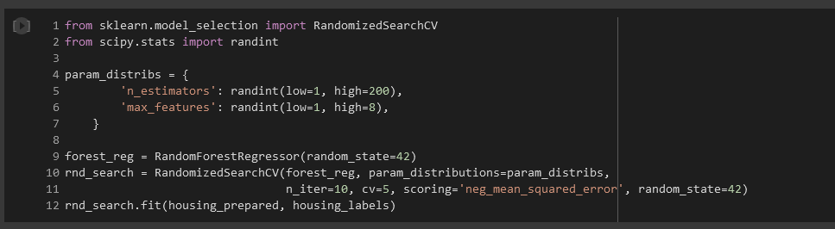
Fine-tuning: Randomized search
Grid search is fine when there are just a few combinations but… how do we know the specific values to try with?
Instead of evaluating all possible pre-defined combinations, Random Search makes the algorithm to evaluate a given number of random combinations by selecting a random value for each hyperparameter at every iteration (we indicate how many iterations).
Master in Quantitative Economic Analysis MQuEA
Universidad Autónoma de Madrid

Slide 15
Fine-tuning: Randomized search
Grid search is fine when there are just a few combinations but… how do we know the specific values to try with?
Instead of evaluating all possible pre-defined combinations, Random Search makes the algorithm to evaluate a given number of random combinations by selecting a random value for each hyperparameter at every iteration (we indicate how many iterations).
Master in Quantitative Economic Analysis MQuEA
Universidad Autónoma de Madrid

